Slide 1
Chapter 3: The Project Management Process Groups
Information Technology Project Management, Ninth Edition
Note: See the text itself for full citations

Slide 2
Learning Objectives (1 of 2)
Describe the
five project management process groups,
the typical level of activity for each, and
the interactions among them
Relate the project management process groups to
the project management knowledge areas
Discuss how organizations
develop information technology (IT) project management methodologies to meet their needs
Review a case study of an organization applying the project management process groups to manage an IT project, describe outputs of each process group, and understand the contribution that effective initiating, planning, executing, monitoring and controlling, and closing make to project success

Slide 3
Learning Objectives (2 of 2)
Review a case study of the same project managed with an agile focus and compare the key differences between an agile approach and a predictive approach
Describe several templates for creating documents for each process group

Slide 4

Project Management Knowledge Areas
Knowledge areas describe
the key competencies that project managers must develop
Project managers must have knowledge and skills in
all 10 knowledge areas:
1
Scope
5
Quality
2
Cost
6
Resources
3
Schedule
7
Procurement
4
Stakeholder
8
Communication
4
Risk
8
Project Integration Management

Slide 5
Introduction
Project management consists of 10 knowledge areas
Integration, scope, schedule, cost, quality, resource, communications, risk, procurement, and stakeholder management
Projects involve five project management process groups
Initiating, planning, executing, monitoring and controlling, and closing
Tailoring these process groups to meet individual project needs increases the chance of success in managing projects

Slide 6
Project Management Process Groups (1 of 2)
A process is a series of actions directed toward a particular result
Project management can be viewed as a number of related processes
Project management process groups
Initiating processes
Planning processes
Executing processes
Monitoring and controlling processes
Closing processes

Slide 7
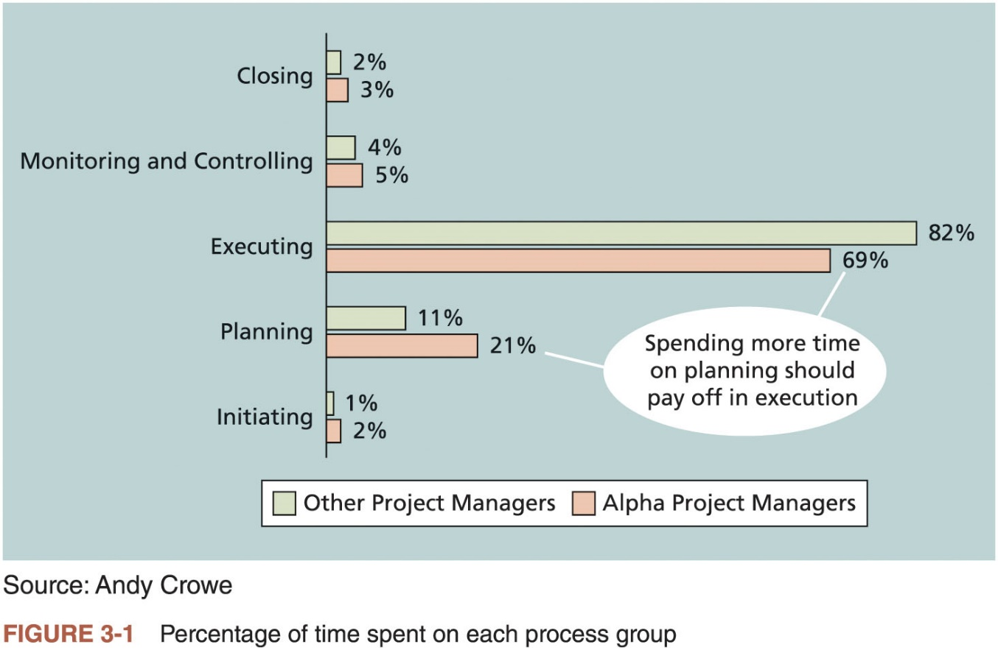
Project Management Process Groups (2 of 2)

Slide 8
What Went Wrong?
Philip A. Pell, PMP, commented on how the U.S. IRS needed to improve its project management process
“Pure and simple, good, methodology-centric, predictable, and repeatable project management is the SINGLE greatest factor in the success (or in this case failure) of any project…”
The IRS continues to have serious problems in managing its aging IT infrastructure, and lack of proper planning is still being questioned

Slide 9
Media Snapshot
Just as information technology projects need to follow the project management process groups, so do other projects, such as the production of a movie
Processes involved in making movies include screenwriting (initiating), producing (planning), acting and directing (executing), editing (monitoring and controlling), and releasing the movie to theaters (closing)
Many people enjoy watching the extra features on a DVD that describe how these processes lead to the creation of a movie
This acted “…not as promotional filler but as a serious and meticulously detailed examination of the entire filmmaking process.”*
Project managers in any field know how important it is to follow a good process
*Jacks, Brian, “Lord of the Rings: The Two Towers Extended Edition (New Line)”, Underground Online (accessed from www.ugo.com August 4, 2004).

Slide 10
Mapping the Process Groups to the Knowledge Areas
You can map the main activities of each PM process group into the ten knowledge areas using the PMBOK® Guide, Sixth Edition
Note that there are activities from each knowledge area under the planning process groups
Table 3-1 provides a big-picture view of the relationships among the 49 project management activities, the process groups in which they are typically completed, and the knowledge areas into which they fit

Slide 11
Developing an IT Project Management Methodology
Many organizations develop their own internal IT project management methodologies
A methodology describes how things should be done
A standard describes what should be done
Different project management methodologies
PRojects IN Controlled Environments (PRINCE2)
Agile
Rational Unified Process (RUP)
Six Sigma

Slide 12
Global Issues
In 2018 PMI published their tenth annual global project management survey (Pulse of the Profession®)
47 percent of projects completed in organizations in the past year used a predictive approach, 23 percent used agile, 23 percent used a hybrid of predictive and agile, and seven percent used other approaches
A 2017 global survey conducted by VersionOne found that 94 percent of respondents said their organizations practiced agile, but 60 percent of their teams were not yet practicing it
The top three benefits of agile listed were the ability to manage changing priorities, increased team productivity, and improved project visibility

Slide 13
What Went Right?
Organizations that excel in project management complete 89 percent of their projects successfully compared to only 36 percent of organizations that do not have good project management processes
PMI estimates that poor project performance costs over $109 million for every $1 billion invested in projects and programs

Slide 14
Case Study: JWD Consulting’s Project Management Intranet Site (Predictive Approach)
This case study provides an example of what’s involved in initiating, planning, executing, controlling, and closing an IT project
You can download templates for creating your own project management documents from the companion website for this text or the author’s site
Note: this case study provides a big picture view of managing a project
Later chapters provide detailed information on each knowledge area

Slide 15
Project Pre-Initiation and Initiation
Initiating includes recognizing and starting a new project
Right kinds of projects for the right reasons
Strategic planning should serve as the foundation for deciding which projects to pursue
Expresses the vision, mission, goals, objectives, and strategies of the organization
Provides the basis for IT project planning

Slide 16
Pre-initiation Tasks
It is good practice to lay the groundwork for a project before it officially starts
Senior managers often perform several pre-initiation tasks
Determine the scope, time, and cost constraints for the project
Identify the project sponsor
Select the project manager
Develop a business case for a project
Meet with the project manager to review the process and expectations for managing the project
Determine if the project should be divided into two or more smaller projects

Slide 17
Initiating (1 of 5)
Knowledge Area | Initiating Process | Initiating Process
Project Integration Management | Develop project charter | Project charter Assumption log
Project Stakeholder Management | Identify stakeholders | Stakeholder register Change requests Project management plan updates Project documents updates
Source: PMBOK® Guide – Sixth Edition, 2017
Table 3-3 Project initiation knowledge areas, processes,
and outputs

Slide 18
Initiating (2 of 5)
Name | Position | Internal/External | Project Role | Contact Information
Joe Fleming | CEO | Internal | Sponsor | joe_fleming@jwdconsulting.com
Erica Bell | PMO Director | Internal | Project Manager | erica_bell@jwdconsulting.com
Michael Chen | Senior Consultant | Internal | Team Member | michael_chen@jwdconsulting.com
Kim Phuong | Business Analyst | External | Advisor | kim_phuong@client1.com
Louise Mills | PR Director | Internal | Advisor | louise_mills@jwdconsulting.com
Table 3-4 Stakeholder Register

Slide 19
Initiating (3 of 5)
Name | Level of Interest | Level of Influence | Potential Management Strategies
Joe Fleming | High | High | Joe likes to stay on top of key projects and make money. Have a lot of short, face-to-face meetings and focus on achieving the financial benefits of the project.
Louise Mills | Low | High | Louise has a lot of things on her plate, and she does not seem excited about this project. She may be looking at other job opportunities. Show her how this project will help the company and her resume.
Table 3-5 Stakeholder Management Strategy

Slide 20
Initiating (4 of 5)
Drafting the project charter
See Table 3-6 for an example
Holding a project kick-off meeting
It’s good practice to hold a kick-off meeting at the beginning of a project so that stakeholders can meet each other, review the goals of the project, and discuss future plans

Slide 21
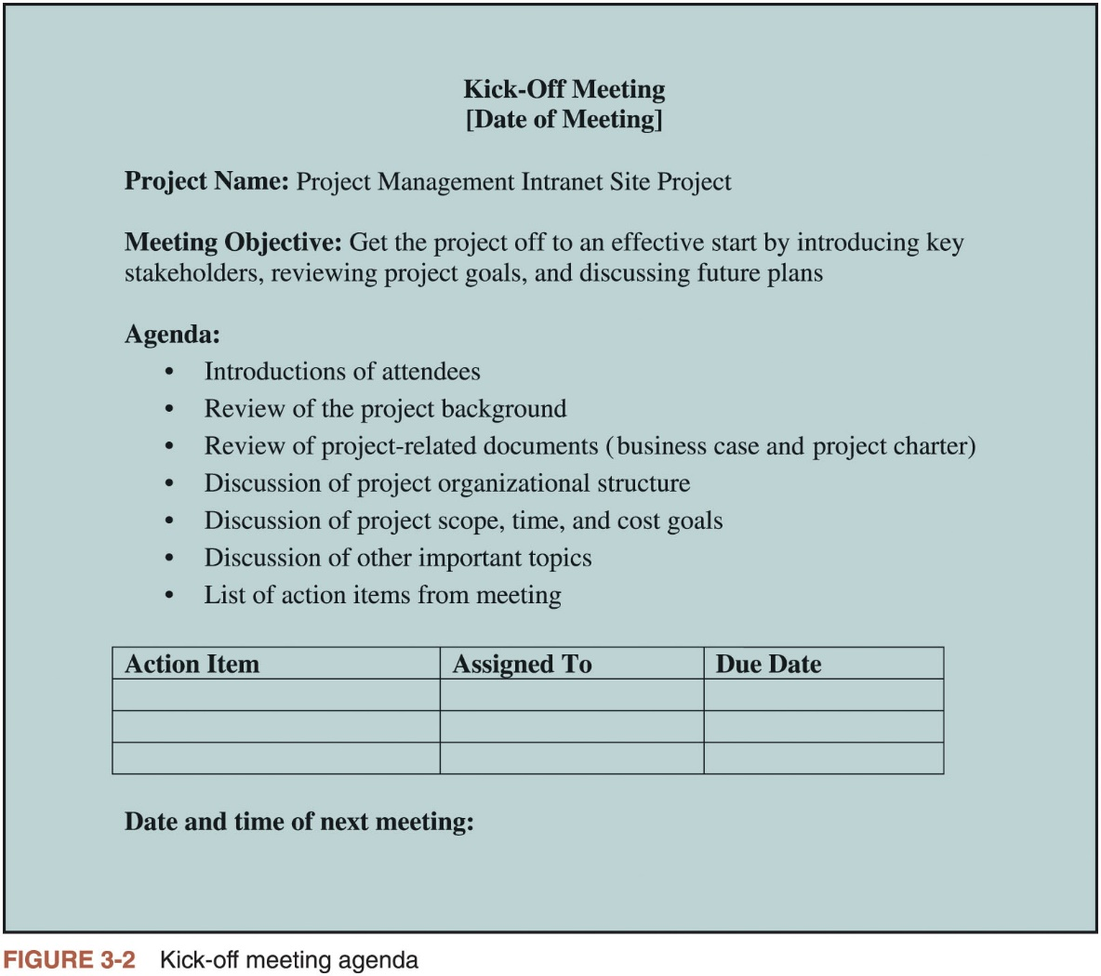
Initiating (5 of 5)

Slide 22
Project Planning (1 of 3)
The main purpose of project planning is to guide execution
Every knowledge area includes planning information (see Table 3-7)
Key outputs included in the JWD project
Team contract
Project scope statement
Work breakdown structure (WBS)
Project schedule, in the form of a Gantt chart with all dependencies and resources entered
List of prioritized risks (part of a risk register)
See sample documents

Slide 23
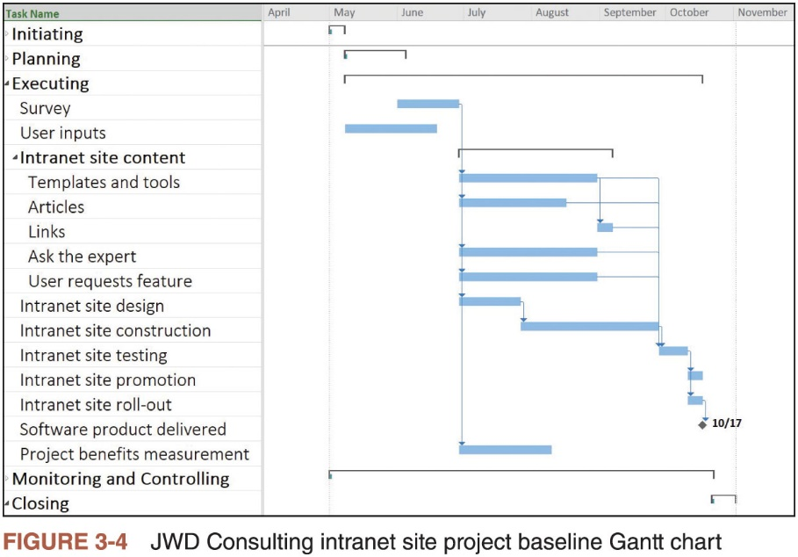
Project Planning (2 of 3)

Slide 24
Project Planning (3 of 3)
Ranking | Potential Risk
1 | Lack of inputs from internal consultants
2 | Lack of inputs from client representatives
3 | Security of new system
4 | Outsourcing/purchasing for the article retrieval and Ask the Expert features
5 | Outsourcing/purchasing for processing online payment transactions
6 | Organizing the templates and examples in a useful fashion
7 | Providing an efficient search feature
8 | Getting good feedback from Michael Chen and other senior consultants
9 | Effectively promoting the new system
10 | Realizing the benefits of the new system within one year
Table 3-10 List of Prioritized Risks

Slide 25
Project Execution
Usually takes the most resources to perform
Project managers must use their leadership skills to handle the many challenges that occur during project execution
Table 3-11 lists the knowledge areas, executing processes, and outputs of project execution
Many project sponsors and customers focus on deliverables related to providing the products, services, or results desired from the project
It is equally important to document change requests and update planning documents
A milestone report can help focus on completing major milestones

Slide 26
Best Practice
One way to learn about best practices in project management is by studying recipients of PMI’s Project of the Year award
The Quartier international de Montreal (QIM), Montreal’s international district, was a 66-acre urban revitalization project in the heart of downtown Montreal
This $90 million, five-year project turned a once unpopular area into a thriving section of the city with a booming real estate market and has generated $770 million in related construction

Slide 27
Project Monitoring and Controlling
Involves measuring progress toward project objectives, monitoring deviation from the plan, and taking correction actions
Affects all other process groups and occurs during all phases of the project life cycle
Outputs include performance reports, change requests, and updates to various plans
See Table 3-13

Slide 28
Project Closing
Involves gaining stakeholder and customer acceptance of the final products and services
Even if projects are not completed, they should be closed out to learn from the past
Outputs may include project files and lessons-learned reports
Also may include a final report and presentation

Slide 29
Case Study 2: JWD Consulting’s Project Management Intranet Site (Agile Approach)
An agile project team typically uses several iterations or deliveries of software instead of waiting until the end of the project to provide one product
Teams do not normally make a snap decision about whether to manage a project using an agile approach or not

Slide 30
Scrum Roles, Artifacts, and Ceremonies (1 of 5)
Product owner: person responsible for the business value of the project and for deciding what work to do and in what order, as documented in the product backlog
ScrumMaster: person who ensures that the team is productive, facilitates the daily Scrum, enables close cooperation across all roles and functions, and removes barriers that prevent the team from being effective
Scrum team or development team: cross-functional team of five to nine people who organize themselves and the work to produce the desired results for each sprint, which normally lasts two to four weeks

Slide 31
Scrum Roles, Artifacts, and Ceremonies (2 of 5)
An artifact is a useful object created by people
Scrum artifacts
Product backlog: list of features prioritized by business value
Sprint backlog: highest-priority items from the product backlog to be completed within a sprint
Burndown chart: shows the cumulative work remaining in a sprint on a day-by-day basis

Slide 32
Scrum Roles, Artifacts, and Ceremonies (3 of 5)
Scrum ceremonies
Sprint planning session: meeting with the team to select a set of work from the product backlog to deliver during a sprint
Daily Scrum: short meeting for the development team to share progress and challenges and plan work for the day
Sprint reviews: meeting in which the team demonstrates to the product owner what it has completed during the sprint
Sprint retrospectives: meeting in which the team looks for ways to improve the product and the process based on a review of the actual performance of the development team

Slide 33
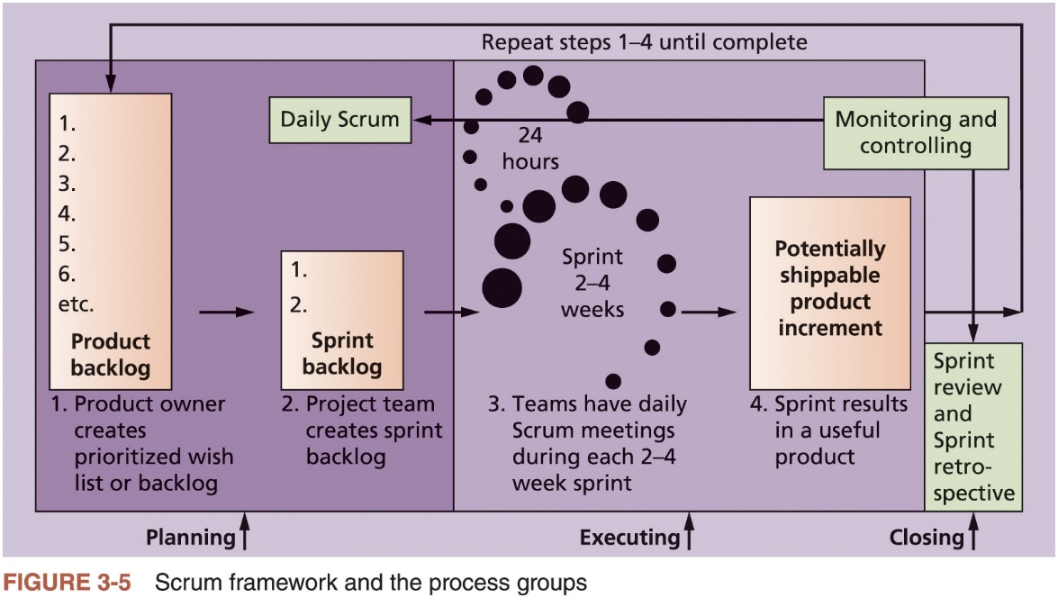
Scrum Roles, Artifacts, and Ceremonies (4 of 5)

Slide 34
Scrum Roles, Artifacts, and Ceremonies (5 of 5)
Process Group | Scrum Activity
Initiating
 | Determine roles
 | Decide how many sprints will compose each release and the scope of software to deliver
Planning
 | Create product backlog
 | Create sprint backlog
 | Create release backlog
 | Plan work each day in the daily Scrum
 | Document stumbling blocks in a list
Executing
 | Complete tasks each day during sprints
 | Produce a shippable product at the end of each sprint
Table 3-18 Unique Scrum activities by process group

Slide 35
Project Pre-Initiation and Initiation
Main differences between pre-initiation in this case and the first case
Determining roles and deciding what functionality would be delivered as part of each release
How many sprints will be required to complete a release
How many releases of software to deliver

Slide 36
Planning (1 of 3)
Because Scrum implies that team members work as a self-directed group, coached by the ScrumMaster, a team charter should not be necessary
Descriptions of work are identified in the product and sprint backlogs
More detailed work is documented in technical stories
Team must estimate a velocity or capacity for each sprint

Slide 37
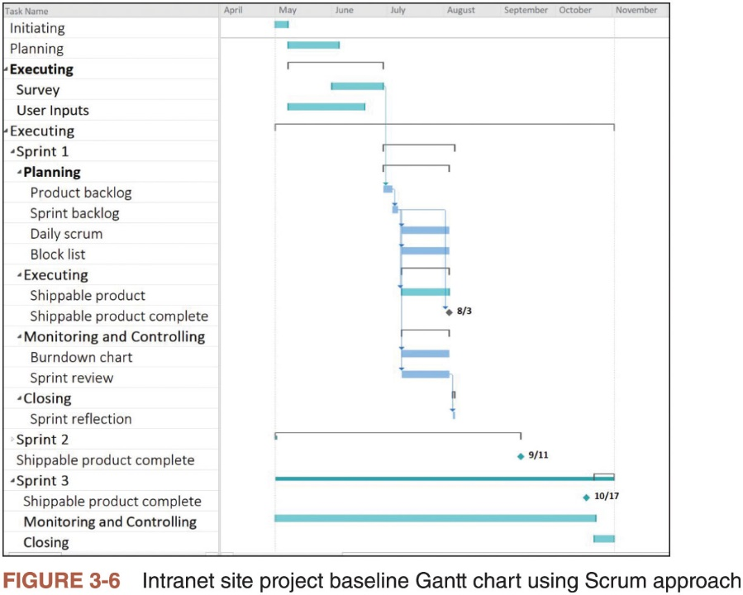
Planning (2 of 3)

Slide 38
Planning (3 of 3)
Product Backlog | Sprint Backlog
1. User story templates, samples, and point person | 1. User story templates, samples, and point person
2. WBS templates, samples, and point person | 2. WBS templates, samples, and point person
3. Project schedule templates, samples, and point person | 3. Project schedule templates, samples, and point person
4. Ability to charge customers for some intranet products and services | 4. Ability to charge customers for some intranet products and services
5. Ability to collect user suggestions | 5. Ability to collect user suggestions
6. Business case templates, samples, and point person
7. Ask the Expert feature
8. Stakeholder management strategy templates, samples, and point person
9. Risk register templates, samples, and point person
10. Etc.
Table 3-19 Product and Sprint Backlogs

Slide 39
Executing
The most time and money should be spent on executing
Plans are implemented to create the desired product
Agile approach: team produces several iterations of a potentially shippable product
Users can access and make suggestions
Communications are different
Project team meets every morning, physically or virtually

Slide 40
Monitoring and Controlling (1 of 2)
The two main tools for monitoring and controlling in the Scrum framework
Daily Scrum: held each morning to plan and communicate work for the day and discuss any risks, issues, or blockers
Sprint review: work progress within a sprint can be represented on a sprint board maintained by the ScrumMaster
Burndown chart: an important artifact used to graphically display progress on each sprint

Slide 41
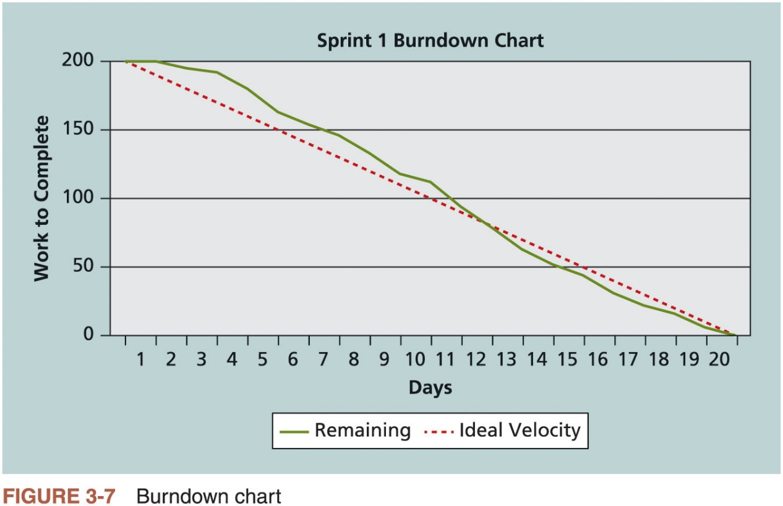
Monitoring and Controlling (2 of 2)

Slide 42
Closing
After the sprint review, the ScrumMaster leads a sprint retrospective
Team reflects on what happened during the sprint
Sprint retrospective is intended to answer two fundamental questions
What went well during the last sprint that we should continue doing?
What could we do differently to improve the product or process?

Slide 43
Templates by Process Group
Table 3-20 lists several templates used to prepare the documents shown in this chapter and later chapters
Download these and additional templates in one compressed file from the Companion website for this text or from the author’s website.

Slide 44
Advice for Young Professionals
Most organizations have templates for many different kinds of documents
Ask your boss, co-workers, and other colleagues for templates
If you don’t like the templates you find, look at other sources
If you can improve them, share your work with others
Templates are great, but completed templates with good information are even more useful

Slide 45
Chapter Summary
The five project management process groups are initiating, planning, executing, monitoring and controlling, and closing
You can map the main activities of each process group to the ten knowledge areas
Some organizations develop their own information technology project management methodologies
The JWD Consulting case study provides an example of using the process groups and shows several important project documents
The second version of the same case study illustrates how to use Scrum, the leading agile method, to manage the project

